Slide 1
Digital Success Programme
Competent STate, (Digital State Governance)

Slide 2
The DSP was a novel answer given for a fierce political situation.
The conservative national government took the initiative of digital transformation based
on the responsibility from the millennial statehood.
DSP1.0 (2015)
DSP2.0 (2017)
DSP 2030 (2019-2020)
It is based on the results of a consultation (InternetKon)
Reflects the suggestions of the public and professional organisations
18 areas, 50+ projects
Implemented, integrated into the execution of new tasks
It is based on the results of NIS (National Infocommunication Strategy) and DSP 1.0
Reflects policy, public administration and professional organisation proposals
90+ projects in 27 areas
Closing implementation: End of 2019
It is based on the research results of the DSP and other government think-tanks and ministries, and on co-governmental cooperation.
A holistic and structured accounting system for government actions related to the development of a country's digital ecosystem.
„Mendeleev's Public Administrative Table”

Slide 3
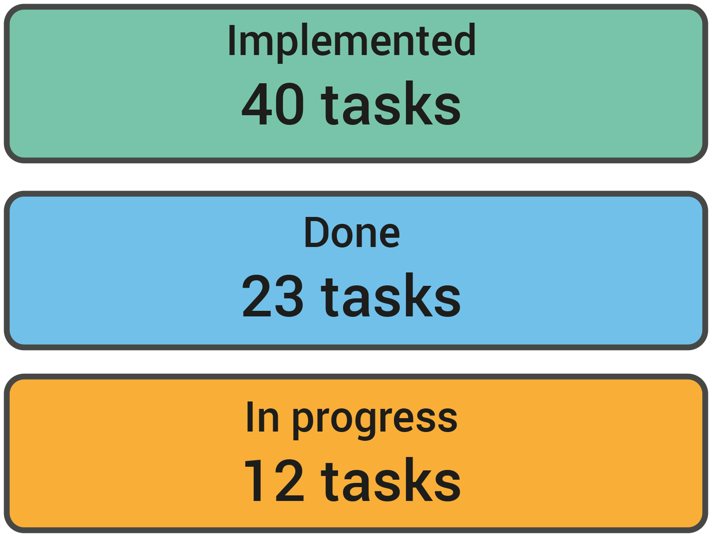
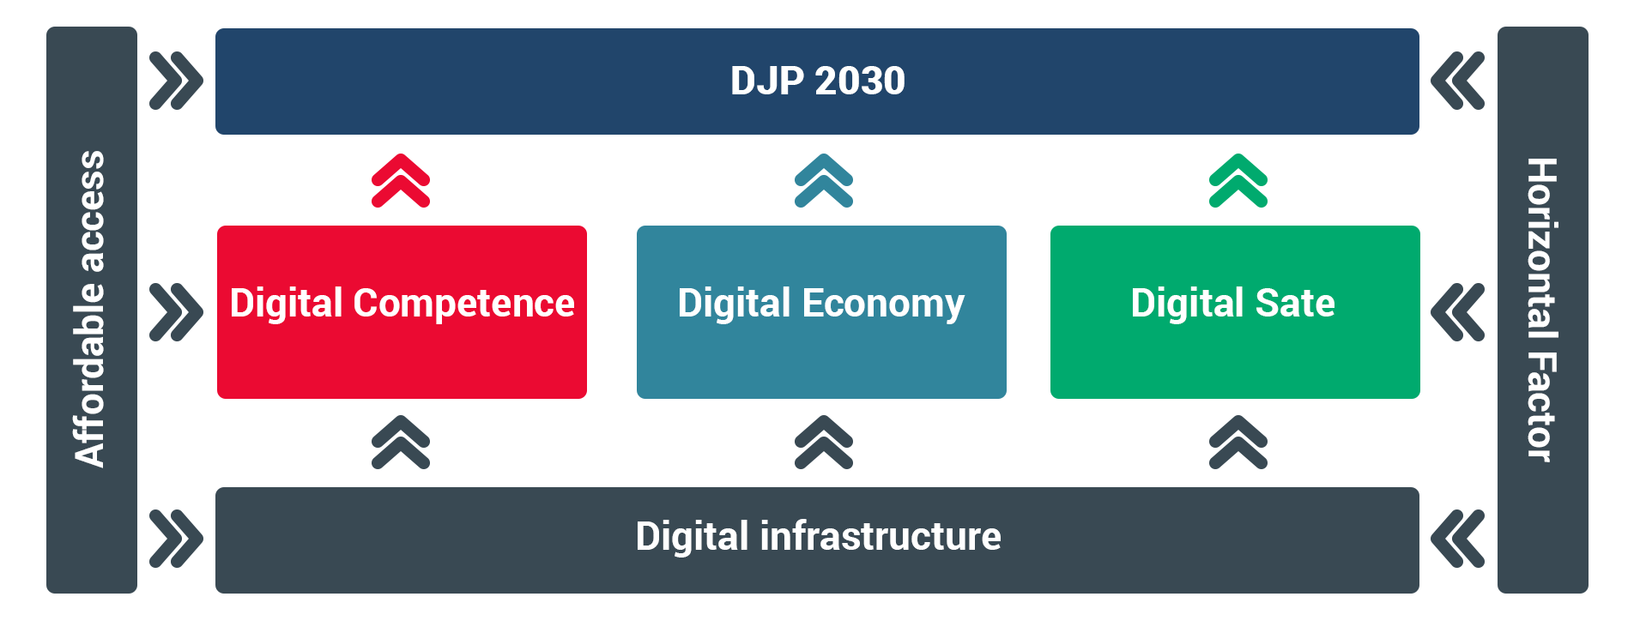

Slide 4
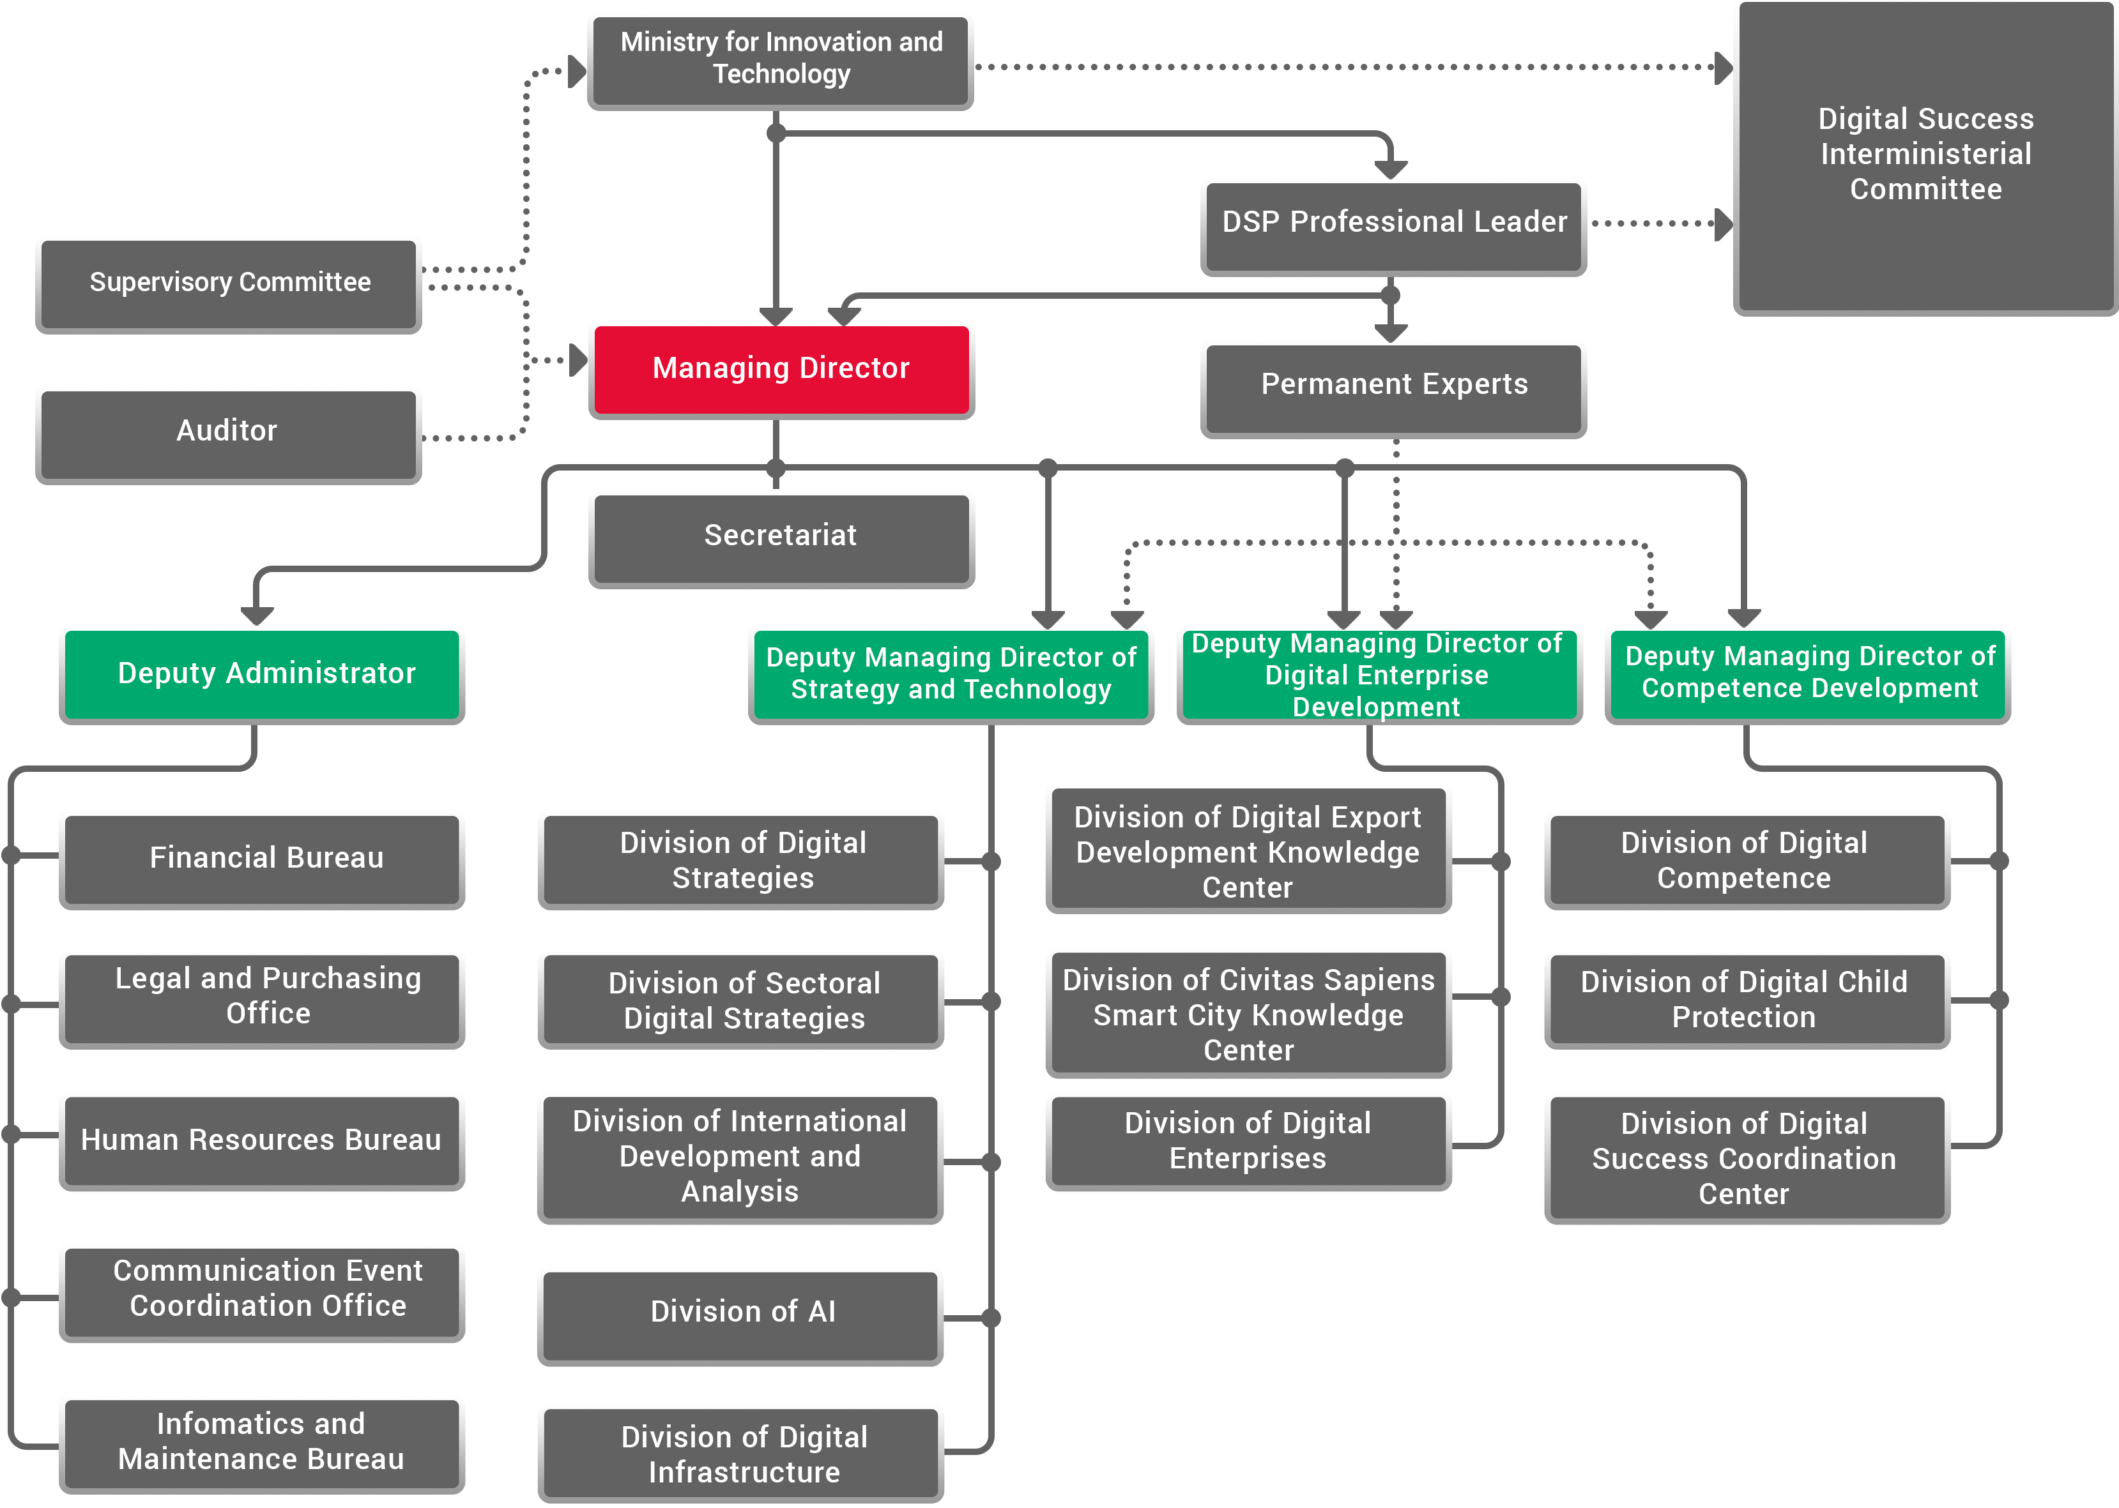
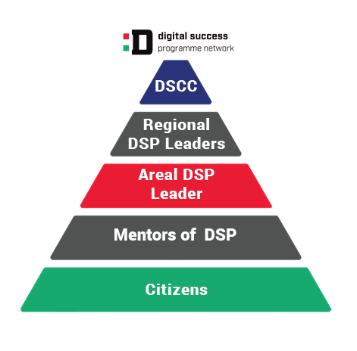

Slide 5
Notes:
Directly involved in the execution of DSP: Digital Success Non-profit Ltd. https://djnkft.hu/ , Neumann Non-profit Ltd. https://www.neum.hu/eng.html
DSP is supported by 2 large professional coalitions: 5G coalition https://5g.hu/ and AI coalition.
Strategic partners: Governmental Agency for IT Development, Infotér Nonprofit Ltd. ,Communications Reconciliation Council-CRC, John von Neumann Computer Society, ICT Association of Hungary, The Association of Hungarian PhD and DLA Candidates, Eötvös Loránd Young Expert System (ELFSZR),
National Council of Hungary for Information & Communication Technology, Young Informatics for the Society Association, Scientific Association for Infocommunications, CED-Central European Economic Development Network Nonprofit Ltd.

Slide 6
Thank you for your attention

